Slide 1
May – June 2015 EXAMINATION RESULTS
Presentation in collaboration
with the Ministry of Education Science, Technology and Innovation of Barbados
14 August 2015

Slide 2
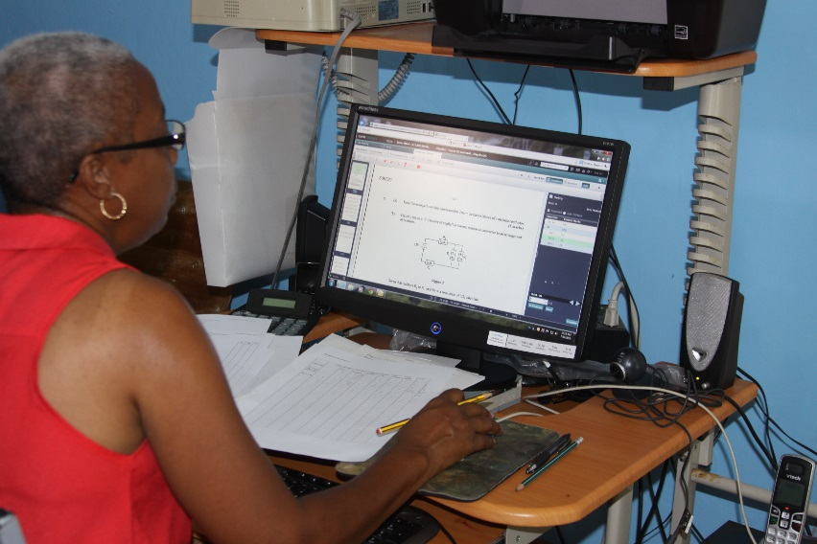
ELECTRONIC MARKING

Slide 3
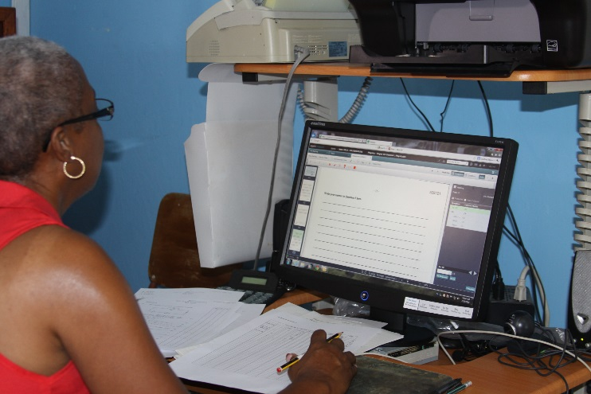
ELECTRONIC MARKING 2015
THE JOURNEY
Early Beginnings – 2010
Four Interations
THE PROCESS
Scanned Scripts
Marker Quotas
Random Seeds
Examiner Review

Slide 4
ELECTRONIC MARKING
Main Improvements
Quality
Seeding
Examiner Sampling
Convenience
Any time
Any Where
Initiative
Self-paced

Slide 5
EXAMINATIONS ADMINISTRATION

Slide 6
ELECTRONIC MARKING: 2016

Slide 7
ELECTRONIC MARKING: 2016

